Slide 1



Power and Stability in World Politics
Paper: International Relations II

Slide 2


Introduction
Power is the ability of a state or actor to influence others to achieve desired outcomes, even against resistance.
How Power Works in IR:
a.Balance of Power: States form alliances to counter stronger powers (e.g., NATO vs. Warsaw Pact).
b. Hegemony: A single dominant power shapes global rules (e.g., U.S. post-Cold War).
c. Deterrence: Threat of force prevents aggression (e.g., U.S. and USSR in the Cold War).

Slide 3


What is Stability in International Relations?
Stability refers to a predictable, conflict-managed system where major wars are avoided, and norms/institutions regulate behavior.
Types of Stability:
Polarity-Based Stability:
Bipolarity (Mearsheimer/Gaddis): Two dominant powers (e.g., Cold War) reduce miscalculations.
Multipolarity (Deutsch): Multiple powers can coexist peacefully with diplomacy (e.g., Concert of Europe).
Institutional Stability:
International organizations (UN, WTO) mediate disputes.
Example: Nuclear Non-Proliferation Treaty (NPT) limiting atomic weapons.
Deterrence Stability:
Mutual vulnerability (e.g., nuclear MAD) prevents war.

Slide 4
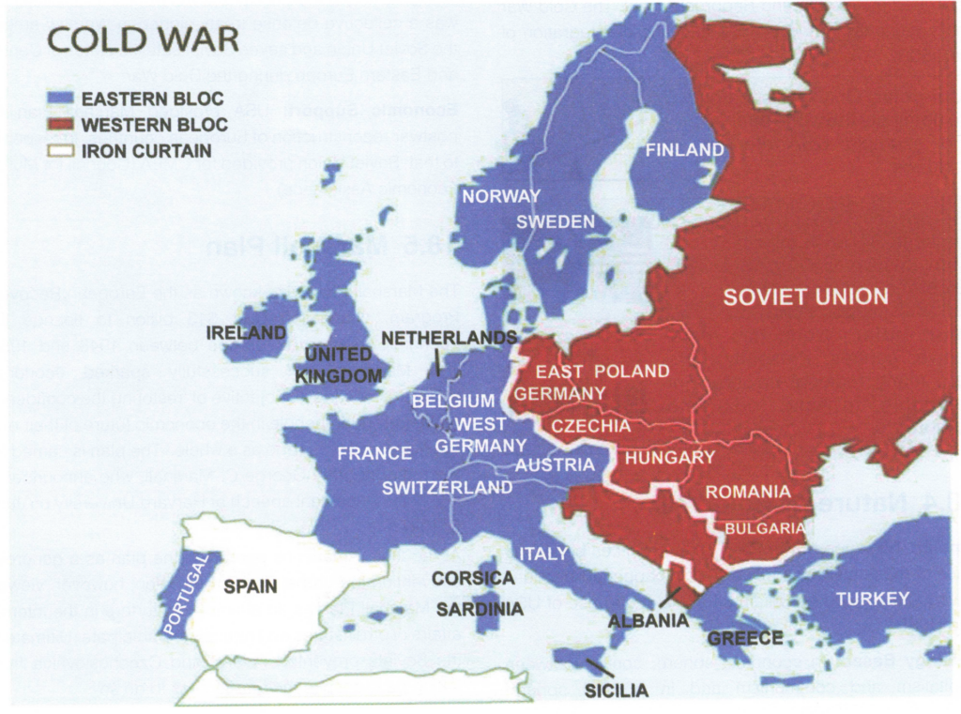

Slide 5
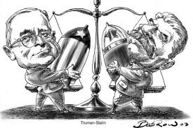

John Mearsheimer – Why We Will Soon Miss the Cold War
Bipolarity = Stability:
The Cold War (US vs. USSR) was stable due to clear power balance and predictable deterrence.
Fewer great powers reduced miscalculations and proxy wars were manageable.
Multipolarity = Instability:
More great powers increase uncertainty, arms races, and potential for major wars.
Example: Pre-WWI Europe (multiple competing powers led to conflict).
Nuclear Deterrence:
MAD (Mutually Assured Destruction) prevented direct superpower war.
Implication: A return to multipolarity (e.g., rise of China) may increase global instability.

Slide 6
Karl W. Deutsch – The Multipolar System and International Stability
Key Arguments:
Multipolarity Can Be Stable:
Stability depends on communication, alliances, and conflict management rather than just power distribution.
Example: 19th-century Concert of Europe (managed multipolarity via diplomacy).
Integration and Interdependence:
Economic/social ties reduce likelihood of war (e.g., EU model).
Institutional Constraints:
International organizations and norms help manage multipolar systems.
Implication: Multipolarity is not inherently unstable if managed through cooperation.

Slide 7
John Lewis Gaddis – The Long Peace: Elements of Stability
Key Arguments:
Post-WWII Stability Factors:
Bipolarity: Clear spheres of influence reduced direct conflict.
Nuclear Deterrence: Made large-scale war irrational.
Hegemonic Control: US and USSR restrained allies (e.g., no nuclear proliferation to Germany/Japan).
Lessons for Peace:
Transparency (e.g., arms control agreements) and predictability matter more than polarity.
Implication: Stability is not just about structure (bipolar/multipolar) but also about rules and restraint.

Slide 8
Comparative Analysis
MEARSHEIMER (BIPOLARITY)
DEUTSCH (MULTIPOLARITY)
GADDIS (LONG PEACE)
ASPECTS
Structure
Key Mechanism
Threats
Bipolar = Stable
Nuclear Deterrence
Multipolar Chaos
Multipolar can be stable
Diplomacy/interdependence
Poor management
Bipolar + Institutions
Rules & restraint
Miscalculation

Slide 9




Democratic Peace THeory ?

Slide 10
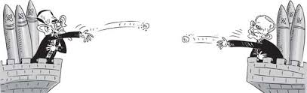
Key Questions:
Does or multipolarity promote stability?
What factors contribute to long-term peace?
How does power distribution shape conflict and cooperation?

Slide 11
Reference:
Mearsheimer, J. (1990). Why We Will Soon Miss the Cold War.
Deutsch, K. W. (1968). The Multipolar System and International Stability.
Gaddis, J. L. (1986). The Long Peace: Elements of Stability.

Slide 12

Thank
you

