Slide 1
WESTERN POLITICAL THOUGHT
Department of Political Science
Unit : Jeremy Bentham
Presented By : Parlina Kalita

Slide 2
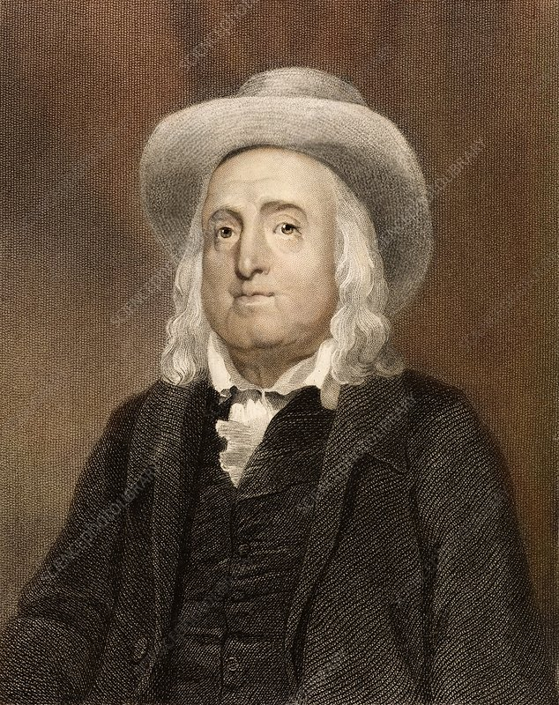
Philosophy of Jeremy Bentham
Jeremy Bentham (1748–1832) was an English philosopher, jurist, and social reformer best known as the founder of Utilitarianism—a moral theory that evaluates actions based on their outcomes, specifically whether they promote happiness or reduce suffering.
Bentham believed that human beings are naturally motivated by the pursuit of pleasure and the avoidance of pain, and that society and government should be organized to maximize overall well-being. His philosophy aimed to make ethics and law more rational, objective, and reform-oriented.
1748–1832

Slide 3
Utilitarianism
Core Idea of Bentham’s Utilitarianism
"The greatest happiness of the greatest number" — Jeremy Bentham
This means that the right action is the one that produces the most overall happiness (or pleasure) and the least overall pain for the greatest number of people.
Key Principles of Bentham's Utilitarianism
Hedonism:
Bentham believed pleasure and pain are the only intrinsic values.
All human actions are driven by a desire to maximize pleasure and minimize pain.
Consequentialism:
The morality of an action depends solely on its outcomes or consequences.
Intentions or motives are not as important as results.

Slide 4
3. Utility Principle (Principle of Utility):
Actions are right if they tend to promote happiness and wrong if they tend to produce the reverse.
4. Hedonic Calculus:
Bentham proposed a system to measure the moral worth of an action by calculating its pleasure vs. pain using factors like:
Intensity: How strong is the pleasure?
Duration: How long does it last?
Certainty: How likely is it?
Propinquity: How soon will it occur?
Fecundity: Will it lead to more pleasure?
Purity: Will it be free from pain?
Extent: How many people will be affected?

Slide 5
Bentham’s Influence
Legal Reform: Bentham was a strong advocate for social and legal reforms, including:
Prison reform
Animal rights
Women's rights
Decriminalization of homosexuality
Political Philosophy:
He promoted democracy, freedom of speech, and individual rights, but always through the lens of maximizing collective happiness.

Slide 6
Criticisms of Bentham’s Utilitarianism
Criticism | Explanation
Ignores Individual Rights | It can justify harming individuals if it benefits the majority (e.g. punishing an innocent person).
Ignores Justice and Fairness | Unjust actions (like slavery or discrimination) could be morally acceptable if they maximize happiness.
All Pleasures Are Equal | Bentham treats all pleasures the same, without considering their quality (e.g. reading = watching TV).
Difficult to Measure Happiness | Pleasure and pain are subjective and can't be accurately measured or compared.
Tyranny of the Majority | The happiness of the majority can override the suffering of a minority, leading to oppression.
Consequences Are Hard to Predict | Moral decisions rely on knowing future outcomes, which is often uncertain or unpredictable.
Too Demanding | It may require people to always act for the greater good, even at great personal cost.
Ignores Motive and Character | It judges actions only by outcomes, not by the person's intentions or moral character.

Slide 7
Conclusion
Jeremy Bentham’s utilitarianism is a groundbreaking ethical theory that emphasizes the importance of maximizing happiness and minimizing pain for the greatest number of people. As a consequentialist and hedonist, Bentham offered a simple, systematic approach to morality using the hedonic calculus to weigh the outcomes of actions. While his theory promotes social welfare and practical decision-making, it has been widely criticized for ignoring justice, individual rights, and the quality of different pleasures. Despite these criticisms, Bentham’s ideas laid the foundation for modern utilitarian thought and continue to influence ethical, legal, and political discussions today.

Slide 8
5 multiple-choice questions on Jeremy Bentham’s Utilitarianism
1. What is the main principle of Bentham’s utilitarianism?
A) Always act according to your duty B) The greatest happiness for the greatest number C) Follow religious teachings D) Treat others as you want to be treated
2. Which of the following is NOT a part of Bentham’s Hedonic Calculus?
A) Intensity B) Duration C) Equality D) Certainty
3. Why is Bentham’s utilitarianism called a consequentialist theory?
A) It focuses on religious rules B) It judges actions based on intentions C) It judges actions based on their outcomes D) It emphasizes following natural laws

Slide 9
4. What is a major criticism of Bentham’s utilitarianism?
A) It considers motives too much B) It ignores pleasure C) It treats all pleasures as equal, without considering quality D) It values justice more than happiness
5. Which of the following scenarios best shows a weakness in Bentham’s utilitarianism?
A) Telling a lie to protect someone’s feelings B) Punishing an innocent person to keep the public happy C) Reading a book for personal growth D) Volunteering to help others
Answers
B – The greatest happiness for the greatest number
C – Equality
C – It judges actions based on their outcomes
C – It treats all pleasures as equal, without considering quality
B – Punishing an innocent person to keep the public happy

Slide 10
THANK YOU

