Slide 1
Annuity
Nirmali Borah
Assistant Professor
Dept. of Commerce(Statistics)

Slide 2
Annuity, types of Annuity
An annuity is a series of equal periodic payments.
Ordinary Annuity: An annuity with payments at the end of the period is known as an ordinary annuity.
Annuity Due: An annuity with payments at the beginning of the period is known as an annuity due.

Slide 3
Present value of ordinary annuity and Annuity due

Slide 4
Future value of ordinary annuity and Annuity due

Slide 5
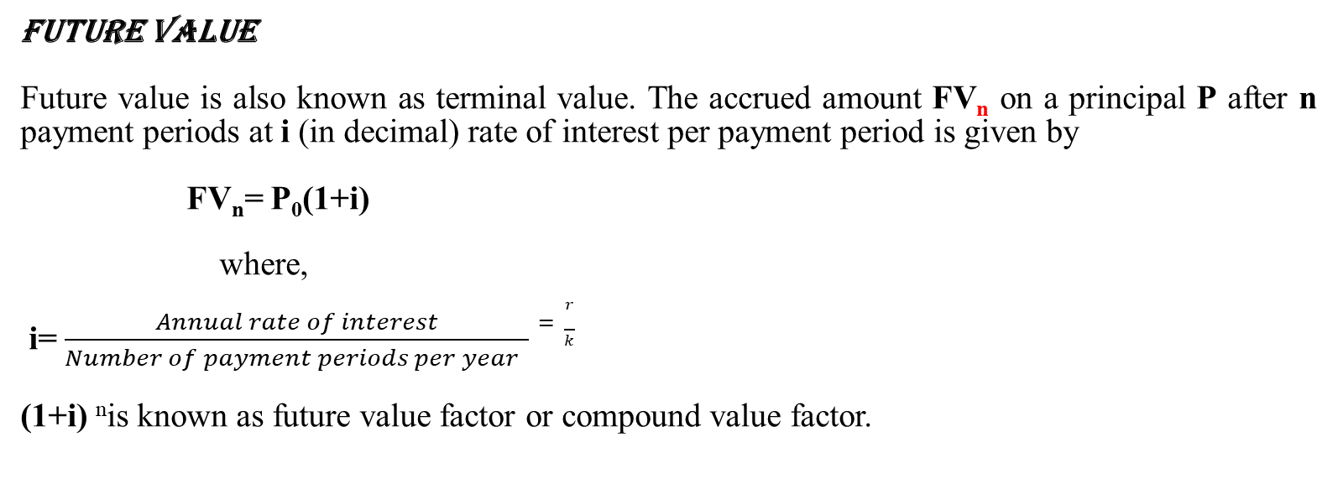
Future Value
Future Value
Future value is also known as terminal value. The accrued amount FV_{n} on a principal P after n payment periods at i (in decimal) rate of interest per payment period is given by
FV_{n}= P₀(1+i)
where,
i= $\frac{Annual rate of interest}{Number of payment periods per year }=\frac{r}{k}$
(1+i) ^{n}is known as future value factor or compound value factor.

Slide 6
Present Value of a Deferred Annuity
In a deferred annuity, the first cash flow is expected to occur more than one period after the date of the agreement.

Slide 7
Thank You

