Slide 1
Skewness and Kurtosis
Nirmali Borah
Assistant Professor
Dept. of Commerce(Statistics)

Slide 2
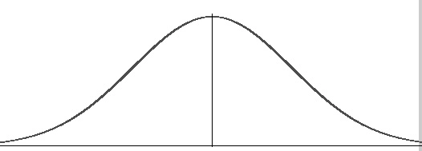
What is a Skewness?
It is the degree of distortion from the symmetrical bell curve or the normal distribution. It measures the lack of symmetry in data distribution.
It differentiates extreme values in one versus the other tail. A symmetrical distribution will have a skewness of 0.
If one tail is longer than another, the distribution is skewed. These distributions are sometimes called asymmetric or asymmetrical distributions as they don’t show any kind of symmetry.
Symmetry means that one half of the distribution is a mirror image of the other half. For example, the normal distribution is a symmetric distribution with no skew.

Slide 3
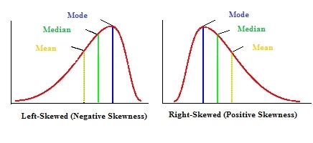
Types of Skewness
A negatively skewed distribution has a long-left tail. That’s because there is a long tail in the negative direction on the number line. The mean is also to the left of the peak.
A positively skewed distribution has a long-right tail. That’s because there is a long tail in the positive direction on the number line. The mean is also to the right of the peak

Slide 4
Kurtosis
Kurtosis is all about the tails of the distribution. It is used to describe the extreme values in one versus the other tail. It is actually the measure of outliers present in the distribution.
High kurtosis in a data set is an indicator that the data has heavy tails or outliers. If there is a high kurtosis, then we need to investigate why do we have so many outliers. It indicates a lot of things, may be wrong data entry or other things. Investigate!
Low kurtosis in a data set is an indicator that the data has light tails or a lack of outliers. If we get low kurtosis(too good to be true), then we also need to investigate and trim the dataset of unwanted results.

Slide 5
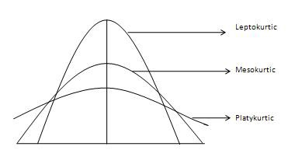
Types of Kurtosis
Mesokurtic: This distribution has kurtosis statistic similar to that of the normal distribution. It means that the extreme values of the distribution are similar to that of a normal distribution characteristic. This definition is used so that the standard normal distribution has a kurtosis of three.
Leptokurtic (Kurtosis > 3): Distribution is longer, tails are fatter. Peak is higher and sharper than Mesokurtic, which means that the data are heavy-tailed or a profusion of outliers.
Platykurtic: (Kurtosis < 3): Distribution is shorter, tails are thinner than the normal distribution. The peak is lower and broader than Mesokurtic, which means that data are light-tailed or lack of outliers.

Slide 6
Thank You

