Slide 1

Power Stability in World Politics
A Theoretical & Structural Analysis of Polarity, Transition, and Geopolitical Equilibrium
MA SECOND SEM | INTERNATIONAL RELATIONS SEMINAR

Slide 2

Foundations of Structural Power
Analyzing systemic stability through the distribution of material capabilities

Slide 3


The Systemic Polarity Debate
Kenneth Waltz (Bipolarity)
Hans Morgenthau (Multipolarity)
Waltz argues that bipolar systems are highly stable because the two superpowers can easily compute their threat levels, establish highly clear defensive alliances, and systematically balance one another, avoiding miscalculation.
Morgenthau asserts that multipolarity fosters stability through diplomacy and fluid alignments. The presence of multiple great powers distributes tension across several dyads, ensuring no single regional dispute escalates into total systemic collapse.

Slide 4


Hegemonic Stability Theory
■
Single Power Leadership: HST posits that the global system achieves maximum stability under a single dominant state (the hegemon).
■
Public Goods Provision: The hegemon reduces global anarchy by establishing and enforcing open economic markets, freedom of navigation, and maritime trade security.
■
Cost of Overstretch: Over time, the heavy costs of protecting these public goods can lead to structural decline, leaving the system unstable.

Slide 5
Evolution of Systemic Configurations
1945-1991
2008-Present
Rigid Bipolarity during the Cold War. Superpower rivalry framed in zero-sum ideological blocks.
Nascent Multipolarity/Bipolarity with the rapid rise of China and regional powers.
1815-1914
1991-2008
Classical Multipolarity of the Concert of Europe, dominated by flexible alliance systems.
The "Unipolar Moment" featuring unchallenged American military and financial hegemony.

Slide 6

Core Balance of Power Behaviors
2
Balancing vs. Bandwagoning
When faced with a dominant threat, states choose one of two distinct structural strategies:
1. Balancing: Forming defensive coalitions (external balancing) or increasing domestic military spending (internal balancing) to negate the rising threat.
2. Bandwagoning: Allying with the threatening hegemon to protect security and share in the spoils of power, typical of smaller or vulnerable nations.
STRATEGIC RESPONSES

Slide 7
Polarity Matrix and Structural Risk
Structure | Theoretical Stability | Key Threat Vector | Core IR Proponents
Unipolarity | Highly Stable (Short Term) | Hegemonic overstretch & imperial decay | Gilpin, Wohlforth
Bipolarity | Robust & Highly Predictable | Ideological proxy conflicts, proxy war trap | Waltz, Mearsheimer
Multipolarity | Dynamic & Fluidly Flexible | Systemic miscalculation & rapid shifting | Morgenthau, Deutsch

Slide 8
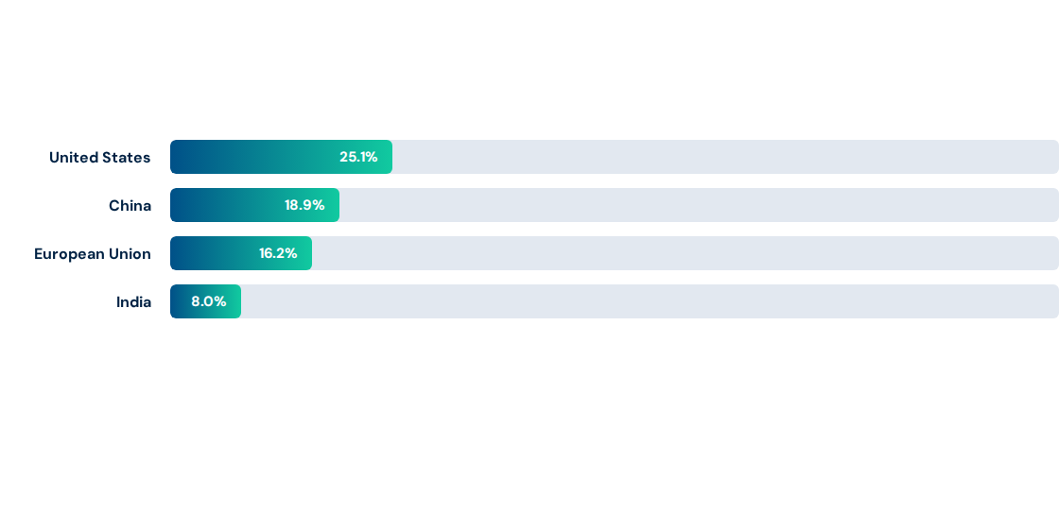
Material Power Shifts: Global GDP Share
Realist power projection is structurally dependent on economic capacity. The convergence of GDP shares among great powers indicates a transition from unipolarity to contested multipolarity.

Slide 9
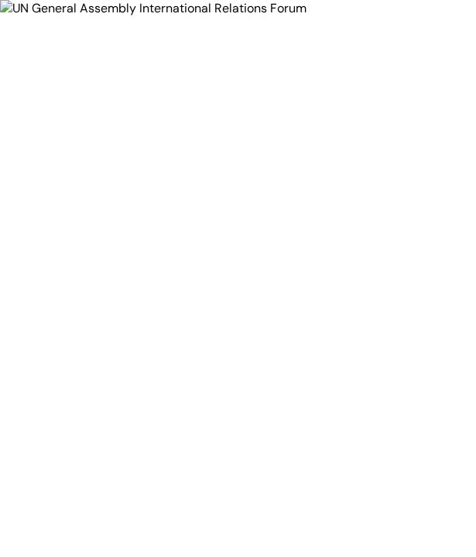
Institutional Roles
Normative Forums or Power Mirrors?
Liberal institutionalists argue that international institutions, like the United Nations, foster stability by decreasing information asymmetry, facilitating repeat interactions, and establishing predictable behaviors.
Conversely, structural realists assert that international institutions are merely reflections of the underlying balance of material power, serving as tools for powerful states to expand their interests.

Slide 10






Contemporary Disruptions to Stability
The Thucydides Trap
De-Globalization
Technological Blocs
Power transitions create massive structural instability as a rising revisionist state approaches the power levels of the reigning hegemon.
The fracturing of global supply networks and rise of bilateral trade protectionism degrade soft-power ties that historically offset military rivalry.
The separation of the cyber realm into competing algorithmic jurisdictions (US vs. China) creates novel sovereign domains outside classic geography.

Slide 11

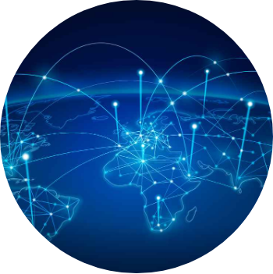
The Technopolar Dimension
Apolar Digital Sovereignty
Modern political analysts describe a rising 'technopolar' dynamic in world politics. Non-state tech giants exercise sovereign power over digital infrastructures, algorithms, and networks that bypass territorial state regulation.
This diffusion of power outside classic state boundaries challenges standard realist paradigms of state-centric military power, introducing a highly fluid dimension to systemic stability.

